Slide 1
Chapter 2 - Communication

Slide 2
Introduction
Interprocess communication is at the heart of all distributed systems
Communication in distributed systems is based on message passing as offered by the underlying network as opposed to using shared memory
Modern distributed systems consist of thousands of processes scattered across an unreliable network such as the Internet
Unless the primitive communication facilities of the network are replaced by more advanced ones, development of large scale Distributed Systems becomes extremely difficult
2

Slide 3
Objectives of the Chapter
Review of how processes communicate in a network (the rules or the protocols) and their structures
Introduce the four widely used communication models for distributed systems:
Remote Procedure Call (RPC)
Remote Method Invocation (RMI)
Message-Oriented Middleware (MOM)
Stream-Oriented Communication
Multicast Communication
3

Slide 4
4.1 Network Protocols and Standards
A protocol is a set of rules that governs data communications
A protocol defines what is communicated, how it is communicated, and when it is communicated
For instance, for one computer to send a message to another computer, the first computer must perform the following general steps
Break the data into small sections called packets
Add addressing information to the packets identifying the source and destination computers
Deliver the data to the network interface card for transmission over the network
4

Slide 5
The receiving computer must perform the same steps, but in reverse order
Accept the data from the NIC
Remove transmitting information that was added by the transmitting computer
Reassemble the packets of data into the original message
The key elements of a protocol are syntax, semantics, and timing
Syntax: refers to the structure or format of the data
Semantics: refers to the meaning of each section of bits
Timing: refers to when data should be sent and how fast they can be sent
Functions of protocols
Each device must perform the same steps the same way so that the data will arrive and reassemble properly; if one device uses a protocol with different steps, the two devices will not be able to communicate with each other
5

Slide 6
Protocols in a layered architecture
Protocols that work together to provide a layer or layers of the model are known as a protocol stack or protocol suite, e.g. TCP/IP
Each layer handles a different part of the communications process and has its own protocol
Data Communication Standards
Standards are essential for interoperability
Data communication standards fall into two categories
De facto standards: that have not been approved by an organized body; mostly set by manufacturers
De jure standards: those legislated by an officially recognized body such as ISO, ITU, ANSI, IEEE
6

Slide 7
Network (Reference) Models
Layers and Services
Within a single machine, each layer uses the services immediately below it and provides services for the layer immediately above it
Between machines, layer x on one machine communicates with layer x on another machine
Two important network models or architectures
The ISO OSI (Open Systems Interconnection) Reference Model
The TCP/IP Reference Model
a. The OSI Reference Model
Consists of 7 layers
Was never fully implemented as a protocol stack, but a good theoretical model
Open – to connect open systems or systems that are open for communication with other systems
7

Slide 8
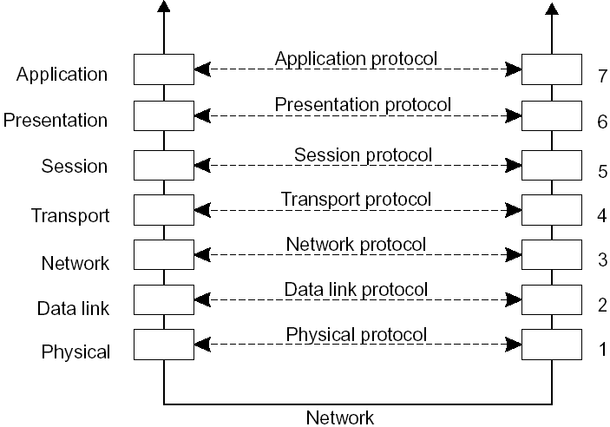
layers, interfaces, and protocols in the OSI model
8

Slide 9
Media (lower) Layers
Physical: Physical characteristics of the media
Data Link: Reliable data delivery across the link
Network: Managing connections across the network or routing
Transport: End-to-end connection and reliability (handles lost packets); TCP (connection-oriented), UDP (connectionless), etc.
Session: Managing sessions between applications (dialog control and synchronization); rarely supported
Presentation: Data presentation to applications; concerned with the syntax and semantics of the information transmitted
Application: Network services to applications; contains protocols that are commonly needed by users; FTP, HTTP, SMTP, ...
Host (upper) Layers
9

Slide 10
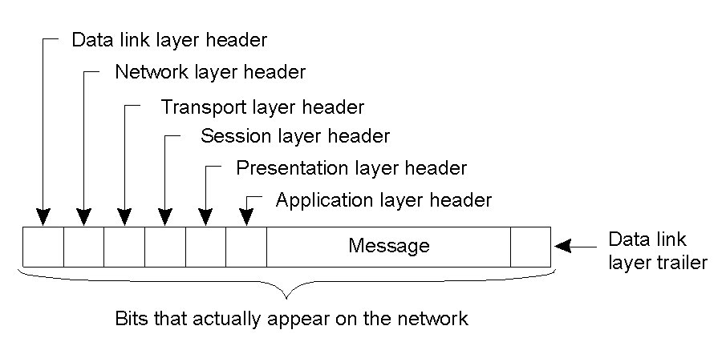
a typical message as it appears on the network
10

Slide 11
b. The TCP/IP Reference Model
TCP/IP - Transmission Control Protocol/Internet Protocol
Used by ARPANET and its successor the Internet
Design goals
The ability to connect multiple networks (internetworking) in a seamless way
The network should be able to survive loss of subnet hardware, i.e., the connection must remain intact as long as the source and destination machines are properly functioning
Flexible architecture to accommodate requirements of different applications - ranging from transferring files to real-time speech transmission
These requirements led to the choice of a packet-switching network based on a connectionless internetwork layer
Has 4 (or 5 depending on how you see it) layers: Application, Transport, Internet (Internetwork), Host-to-network (some split it into Physical and Data Link)
11

Slide 12
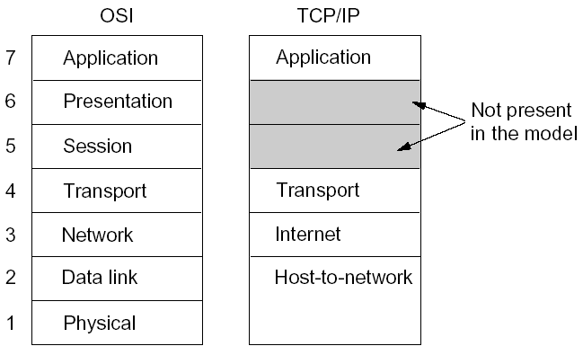
OSI and TCP/IP Layers Correspondence
12

Slide 13
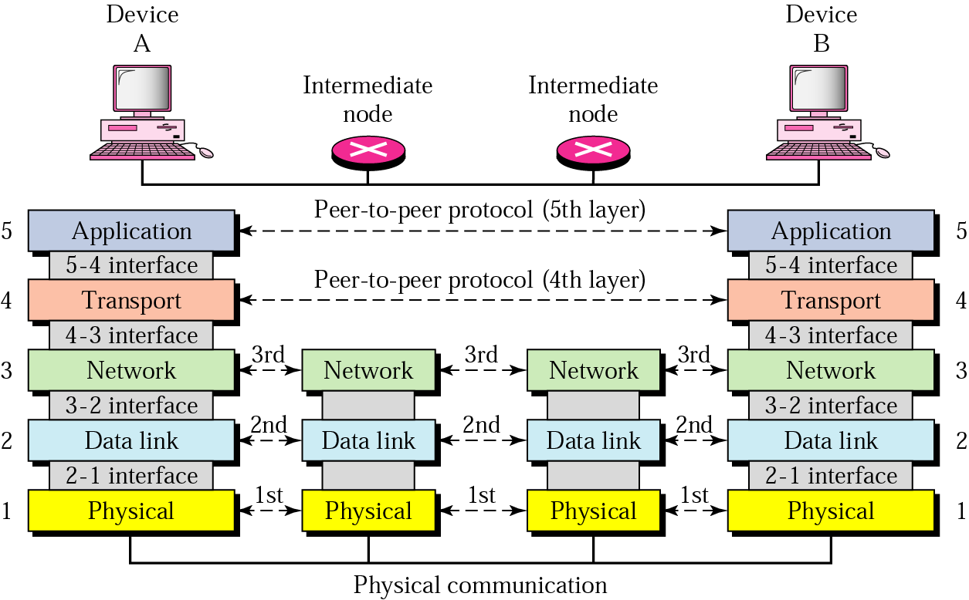
Layers involved in various hosts (TCP/IP)
When a message is sent from device A to device B, it may pass through many intermediate nodes
The intermediate nodes usually involve the first three layers
13

Slide 14
Middleware Protocols
A middleware is an application that contains general-purpose protocols to provide services
Example of middleware services
Authentication and authorization services
Distributed transactions (commit protocols; locking mechanisms)
Middleware communication protocols (calling a procedure or invoking an object remotely, synchronizing streams for real-time data, multicast services) - see later in this Chapter
Hence an adapted reference model for networked communications is required
14

Slide 15
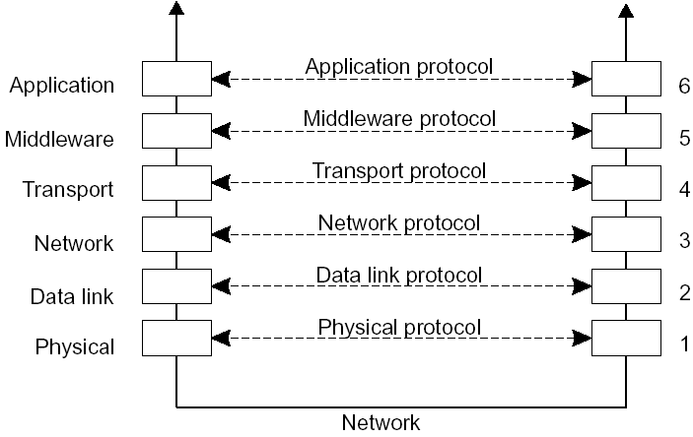
an adapted reference model for networked communication
15

Slide 16
4.2 Remote Procedure Call
The first distributed systems were based on explicit message exchange between processes through the use of explicit send and receive procedures; but do not allow access transparency
In 1984, Birrel and Nelson introduced a different way of handling communication: RPC
It allows a program to call a procedure located on another machine
Simple and elegant, but there are implementation problems
The calling and called procedures run in different address spaces
Parameters and results have to be exchanged; what if the machines are not identical?
What happens if both machines crash?
16

Slide 17
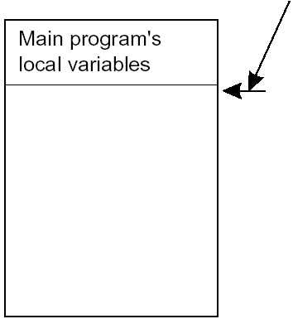
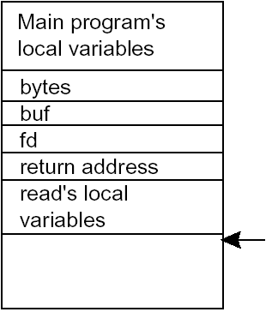
Conventional Procedure Call, i.e., on a single machine
e.g. count = read (fd, buf, bytes); a C like statement, where
fd is an integer indicating a file
buf is an array of characters into which data are read
bytes is the number of bytes to be read
Stack pointer
Stack pointer
parameter passing in a local procedure call: the stack before the call to read
the stack while the called procedure is active
Parameters can be call-by-value (fd and bytes) or call-by reference (buf) or in some languages call-by-copy/restore
17

Slide 18
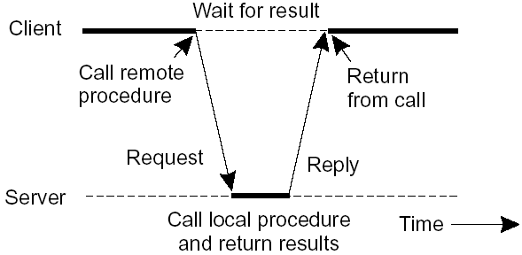
Client and Server Stubs
RPC would like to make a remote procedure call look the same as a local one; it should be transparent, i.e., the calling procedure should not know that the called procedure is executing on a different machine or vice versa
When a program is compiled, it uses different versions of library functions called client stubs
A server stub is the server-side equivalent of a client stub
principle of RPC between a client and server program
18

Slide 19
Steps of a Remote Procedure Call
Client procedure calls client stub in the normal way
Client stub builds a message and calls the local OS (packing parameters into a message is called parameter marshaling)
Client's OS sends the message to the remote OS
Remote OS gives the message to the server stub
Server stub unpacks the parameters and calls the server
Server does the work and returns the result to the stub
Server stub packs it in a message and calls the local OS
Server's OS sends the message to the client's OS
Client's OS gives the message to the client stub
Stub unpacks the result and returns to client
Hence, for the client remote services are accessed by making ordinary (local) procedure calls; not by calling send and receive
server machine vs server process; client machine vs client process
19

Slide 20
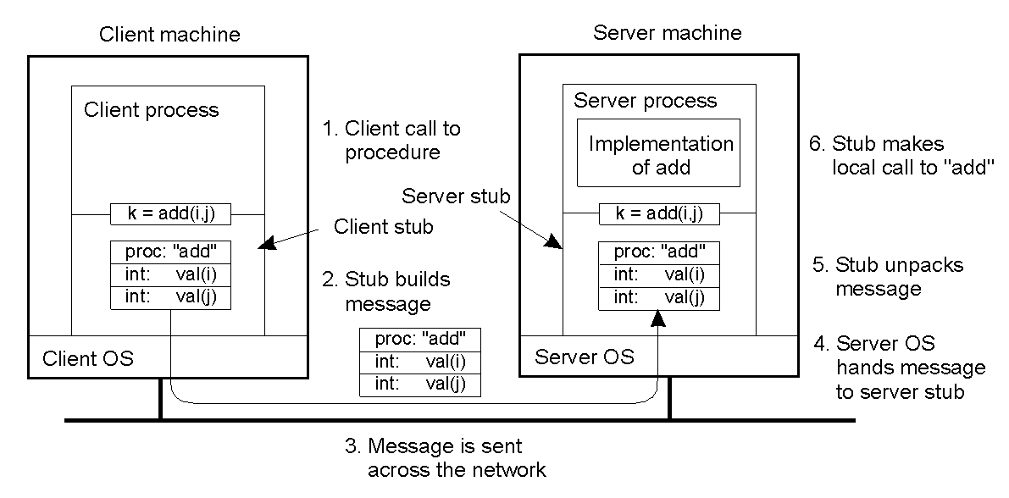
Parameter Passing
1. Passing Value Parameters
e.g., consider a remote procedure add(i, j), where i and j are integer parameters
steps involved in doing remote computation through RPC
20

Slide 21
The above discussion applies if the server and the client machines are identical
But that is not the case in large distributed systems
The machines may differ in data representation (e.g., IBM mainframes use EBCDIC whereas IBM PCs use ASCII)
There are also differences in representing integers(1’s complement or 2’s complement) and floating-point numbers
Byte numbering may be different (from right to left in Pentium called little endian and left to right in SPARC, big endian)
e.g.
Consider a procedure with two parameters, an integer and a four-character string; each one 32-bit word (5, “JILL”)
The sender is Intel and the receiver is SPARC
21

Slide 22
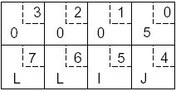
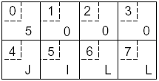
Original message on the Pentium
(the numbers in boxes indicate the address of each byte)
The message after receipt on the SPARC; wrong integer (2²⁴+2²⁶ = 83,886,080), but correct string
22

Slide 23
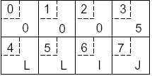
one approach is to invert the bytes of each word after receipt
the message after being inverted (correct integer but wrong string)
Additional information is required to tell which is an integer and which is a string
23

Slide 24
2. Passing Reference Parameters
Assume the parameter is a pointer to an array
Copy the array into the message and send it to the server
The server stub can then call the server with a pointer to this array
The server then makes any changes to the array and sends it back to the client stub which copies it to the client
This is in effect call-by-copy/restore
Optimization of the method
One of the copy operations can be eliminated if the stub knows whether the parameter is input or output to the server
If it is an input to the server (e.g., in a call to write), it need not be copied back
If it is an output, it need not be sent over in the first place; only send the size
The above procedure can handle pointers to simple arrays and structures, but difficult to generalize it to an arbitrary data structure
24

Slide 25

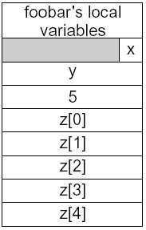
Parameter Specification and Stub Generation
the caller and the callee need to use the same protocol (format of messages) and the same steps; with such rules the client and server stubs can assemble, communicate, and interpret messages correctly
consider the following example; the procedure foobar has 3 parameters: a character, a floating point number, and an array of 5 integers
Assume a word is 4 bytes
One possibility is to transmit the character in the rightmost byte, a float as a whole word, and an array as a group of words equal to the array length preceded by a word giving the length
This way both client stub and server stub can understand outgoing and incoming messages
the corresponding message
25

Slide 26
Other issues that need the agreement of the client and the server
How are simple data structures like integers (e.g. 2’s complement), characters (e.g. 16-bit Unicode), Booleans, ... represented?
Endianess
Which transport protocol to use - the connection-oriented TCP or the unreliable connectionless UDP
26

Slide 27
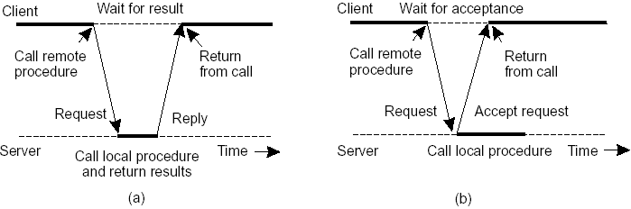
Asynchronous RPC
A shortcoming of the original model: no need of blocking for the client in some cases
two cases
1. if there is no result to be returned
e.g., inserting records in a database, ...
the server immediately sends an ack promising that it will carryout the request
the client can now proceed without blocking
the interconnection between client and server in a traditional RPC
the interaction using asynchronous RPC
27

Slide 28
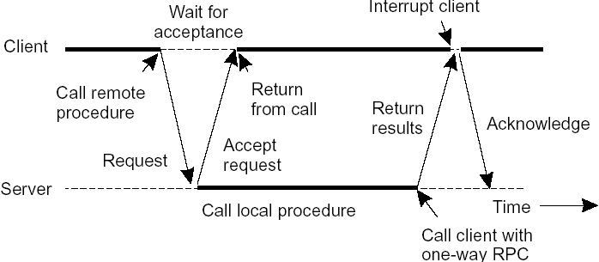
2. if the result can be collected later
e.g., prefetching network addresses of a set of hosts, ...
the server immediately sends an ack promising that it will carryout the request
the client can now proceed without blocking
the server later sends the result
a client and server interacting through two asynchronous RPCs
28

Slide 29
the above method combines two asynchronous RPCs and is sometimes called deferred synchronous RPC
variants of asynchronous RPC
let the client continue without waiting even for an ack, called one-way RPC
problem: if reliability of communication is not guaranteed
29

Slide 30
DCE (Distributed Computing Environment) RPC
a middleware and an example RPC system developed by OSF (Open Software Foundation), now The Open Group
it is designed to execute as a layer of abstraction between existing OSs and distributed applications
The Open Group sells the source code and vendors integrate it into their systems
it uses the client-server programming model and communication is by means of RPCs
services
distributed file service: a worldwide file system that provides a transparent way of accessing files
directory service: to keep track of the location of all resources in the system (machines, printers, data, servers, ...); a process can ask for a resource without knowing its location
security service: for protecting resources; access is only through authorization
30

Slide 31
distributed time service: to maintain clocks on different machines synchronized (clock synchronization is covered in Chapter 6)
Steps in writing a Client and a Server in DCE RPC
the system consists of languages, libraries, daemons, utility programs, ... for writing clients and servers
IDL (Interface Definition Language) is the interface language - the glue that holds everything together
it contains type definitions, constant declarations and what the procedures do (only their syntax)
31

Slide 32
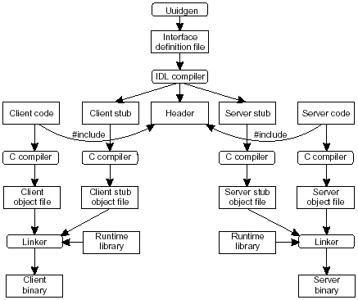
Edit file
Uuidgen generates a prototype IDL file with a globally unique interface identifier
the IDL file is edited (filling the names of procedures and parameters) and the IDL compiler is called to generate 3 files
the application writer writes the client and server codes and are then compiled and linked together with the stubs
32

Slide 33
Binding a Client to a Server in DCE RPC
for a client to call a server, the server must be registered (1 & 2 in the following figure)
the registration allows the client to locate the server and bind to it
the DCE daemon maintains a table (server, endpoint) and the protocols the server uses
the directory server maintains the locations of all resources in the system (machines, servers, data,, ...)
two steps for server location
locate the server’s machine (3)
locate the server process on that machine (which has what is called an endpoint or port) (4)
33

Slide 34
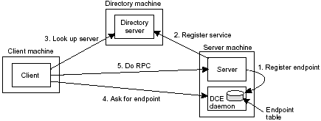
34

Slide 35
4.3 Message-Oriented Communication
RPC and remote object invocations contribute to hiding communication in distributed systems, that is, they enhance access transparency.
But they have semantics that is not adequate for all applications
Example problems
They assume that the receiving side is running at the time of communication
A client is blocked until its request has been processed
35

Slide 36
Communication in distributed system can be
persistent or transient
asynchronous or synchronous
persistent: a message that has been submitted for transmission is stored by the communication system as long as it takes to deliver it to the receiver
e.g., email delivery, snail mail delivery
transient: a message that has been submitted for transmission is stored by the communication system only as long as the sending and receiving applications are executing
asynchronous: a sender continues immediately after it has submitted its message for transmission
synchronous: the sender is blocked until its message is stored in a local buffer at the receiving host or delivered to the receiver
36

Slide 37
Message-Oriented Transient Communication
many applications are built on top of the simple message-oriented model offered by the transport layer
standardizing the interface of the transport layer by providing a set of primitives allows programmers to use messaging protocols
they also allow porting applications
1. Berkley Sockets
an example is the socket interface as used in Berkley UNIX
a socket is a communication endpoint to which an application can write data that are to be sent over the network, and from which incoming data can be read
A socket forms an abstraction over the actual communication end point that is used by the local operating system for a specific transport protocol
37

Slide 38
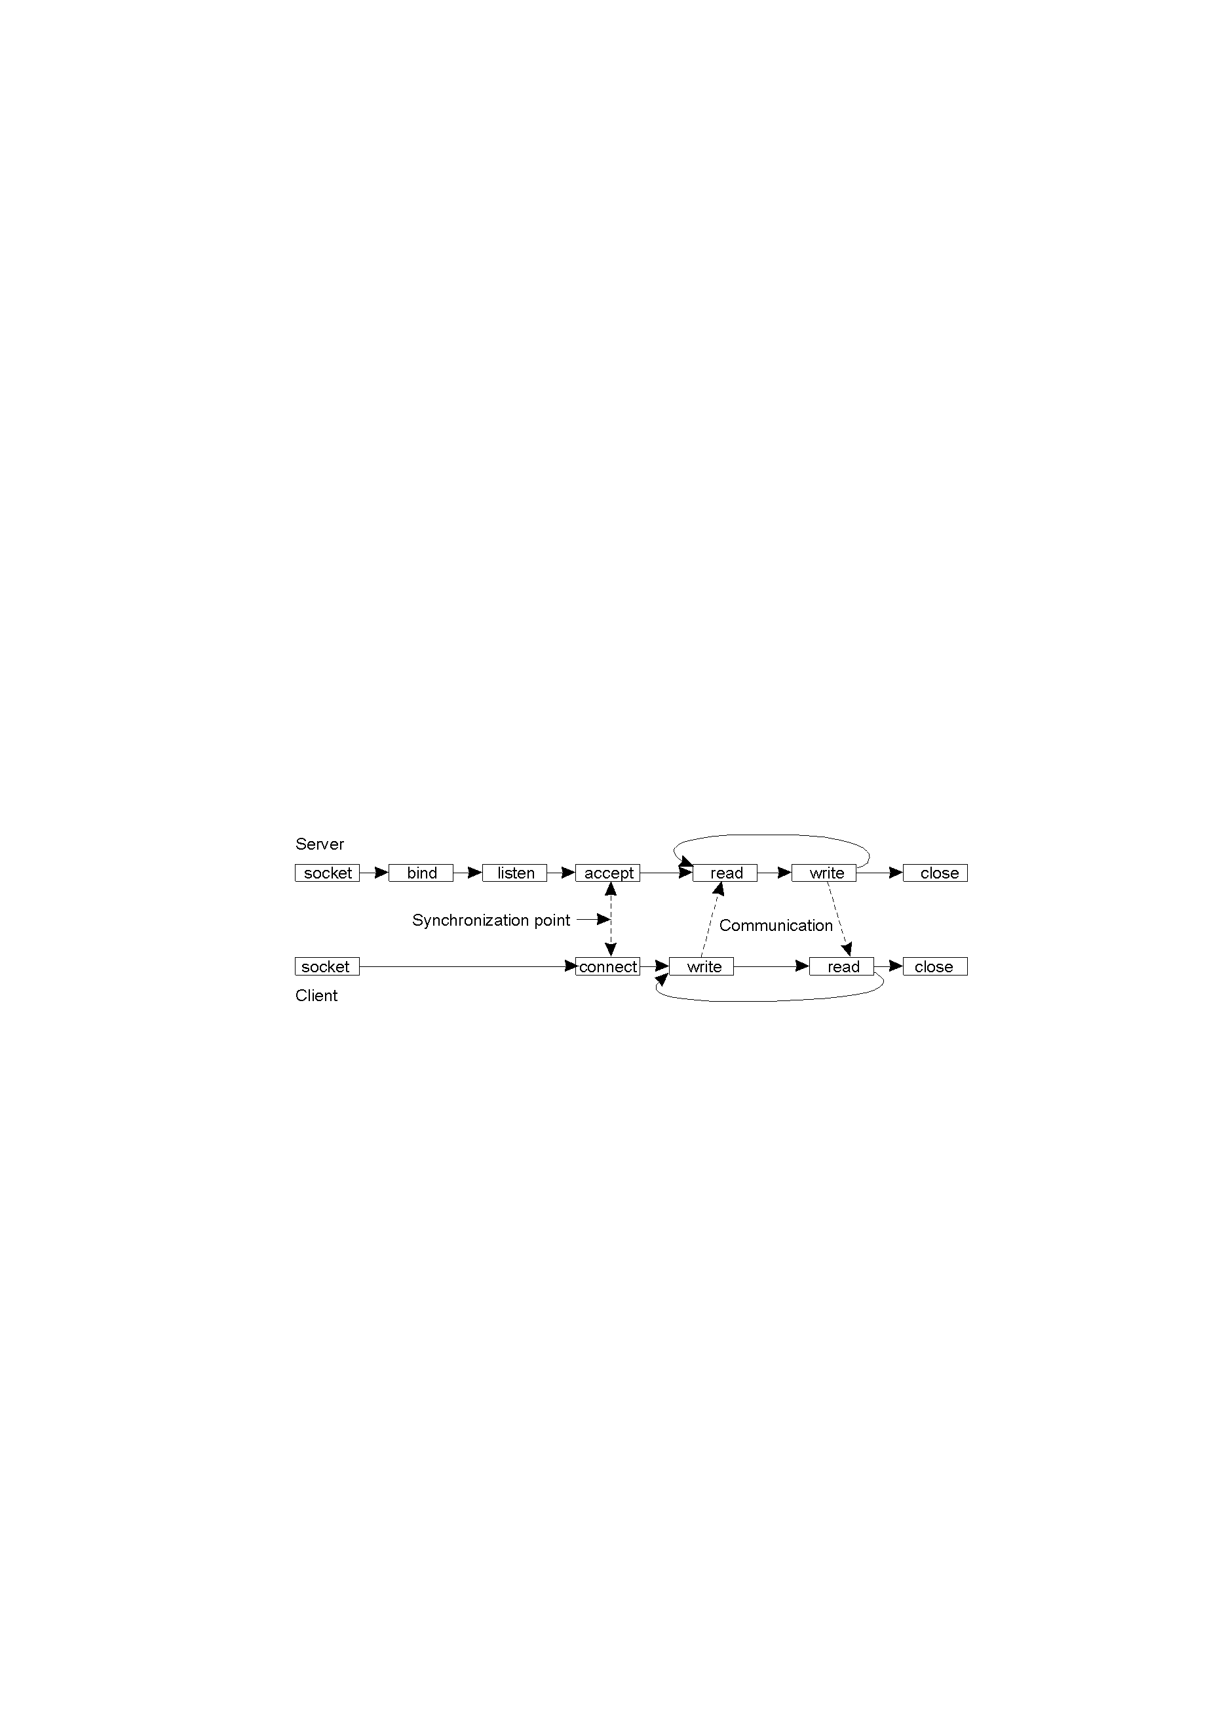
When calling the socket primitive, the caller creates a new communication end point for a specific transport protocol.
The bind primitive associates a local address with the newly-created socket.
For example, a server should bind the IP address of its machine together with a (possibly well-known) port number to a socket.
Binding tells the operating system that the server wants to receive messages only on the specified address and port.
The listen primitive is called only in the case of connection-oriented communication.
connection-oriented communication pattern using sockets
38

Slide 39
Primitive
Meaning
Executed by
Socket
Create a new communication endpoint
both
Bind
Attach a local address to a socket; e.g., IP address with a known port number
servers
Listen
Announce willingness to accept connections
Accept
Block caller until a connection request arrives
Connect
Actively attempt to establish a connection; the client is blocked until connection is set up
Send
Send some data over the connection
Receive
Receive some data over the connection
Close
Release the connection
socket primitives for TCP/IP
39

Slide 40
2. The Message-Passing Interface (MPI)
Sockets were deemed insufficient for two reasons.
First, they were at the wrong level of abstraction by supporting only simple send and receive primitives.
Second, sockets had been designed to communicate across networks using general-purpose protocol stacks such as TCPIIP but they were not designed for proprietary protocols developed for high-speed interconnection networks.
MPI is designed for parallel applications and tailored for transient communication
MPI assumes communication takes place within a known group of processes, where each group is assigned an identifier (groupID) and Each process within a group is also assigned an identifier (processID)
A (groupID, processID) identifies the source or destination of a message, and is used instead of a transport-level address
40

Slide 41
some of the most intuitive message-passing primitives of MPI
Primitive | Meaning
MPI_bsend | Append outgoing message to a local send buffer
MPI_send | Send a message and wait until copied to local or remote buffer
MPI_ssend | Send a message and wait until receipt starts
MPI_sendrecv | Send a message and wait for reply
MPI_isend | Pass reference to outgoing message, and continue
MPI_issend | Pass reference to outgoing message, and wait until receipt starts
MPI_recv | Receive a message; block if there are none
MPI_irecv | Check if there is an incoming message, but do not block
41

Slide 42
Message-Oriented Persistent Communication
there are message-oriented middleware services, called Message-Queuing Systems or Message-Oriented Middleware (MOM)
they support persistent asynchronous communication
Its essence is that they offer intermediate-term storage capacity for messages, without requiring either the sender or receiver to be active during message transmission.
An important difference with Berkeley sockets and MPI is that message-queuing systems are typically targeted to support message transfers that are allowed to take minutes instead of seconds or milliseconds.
Message-Queuing Model
applications communicate by inserting messages in specific queues
it permits loosely-coupled communication (delivered to the destination, even if it was down when the message was sent)
Thus, the sender may or may not be running; similarly the receiver may or may not be running, giving four possible combinations
42

Slide 43
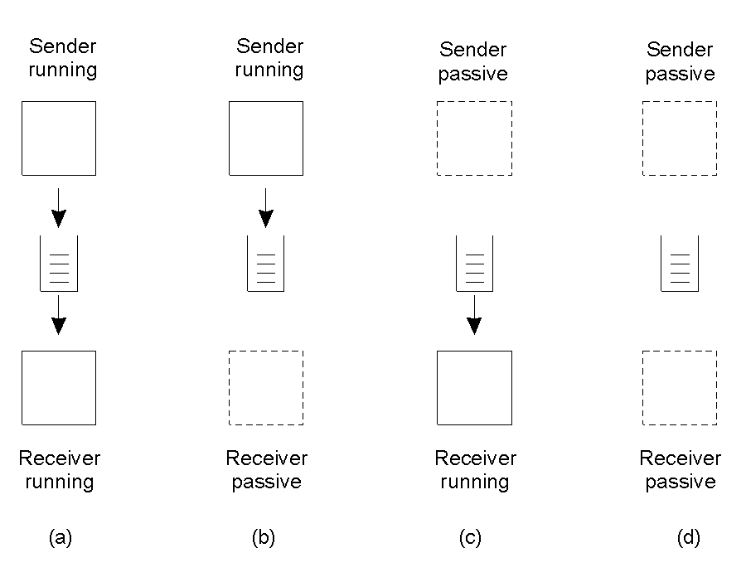
four combinations for loosely-coupled communications using queues
43

Slide 44
Primitive | Meaning
Put | Append a message to a specified queue; by the sender and is non-blocking
Get | Block until the specified queue is nonempty, and remove the first message
Poll | Check a specified queue for messages, and remove the first. Never block
Notify | Install a handler to be called when a message is put into the specified queue; usually a daemon
basic interface to a queue in a message-queuing system
44

Slide 45
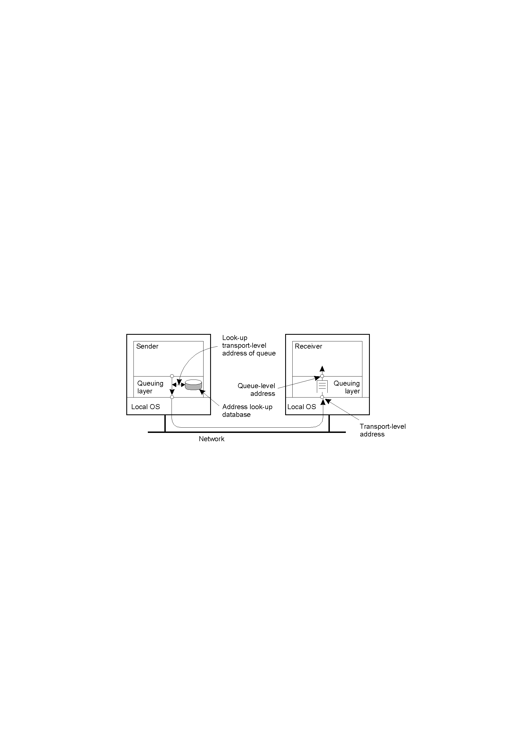
General Architecture of a Message-Queuing System
messages can be put only into queues that are local to the sender (same machine or on a nearby machine on a LAN)
such a queue is called the source queue
Likewise, messages can be read only from local queues.
a message put into a local queue must contain the specification of the destination queue; hence a message-queuing system must maintain a mapping of queues to network locations; like in DNS.
It is the responsibility of a message-queuing system to provide queues to senders and receivers and take care that messages are transferred from their source to their destination queue.
the relationship between queue-level addressing and network-level addressing
45

Slide 46
messages are managed by queue managers
normally, a queue manager interacts directly with the application that is sending or receiving a message.
However, there are also special queue managers that operate as routers, or relays: they forward incoming messages to other queue managers.
But, each queue manager needs a copy of the queue-to-location mapping, leading to network management problems for large-scale queuing systems
the solution is to use a few routers that know about the network topology
46

Slide 47
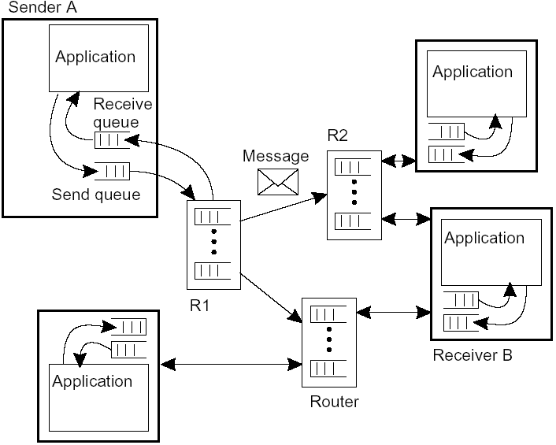
the general organization of a message-queuing system with routers
47

Slide 48
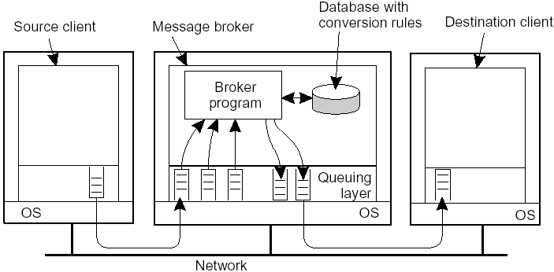
Message Brokers
how can applications understand the messages they receive
each receiver can not be made to understand message formats of new applications
hence, in a message-queuing system conversations are handled by message brokers
a message broker converts incoming messages to a format that can be understood by the destination application based on a set of rules
the general organization of a message broker in a message-queuing system
48

Slide 49
4.4 Stream-Oriented Communication
until now, we focused on exchanging independent and complete units of information
time has no effect on correctness; a system can be slow or fast
however, there are communications where time has a critical role
Multimedia
media
storage, transmission, interchange, presentation, representation and perception of different data types:
text, graphics, images, voice, audio, video, animation, ...
movie: video + audio + …
multimedia: handling of a variety of representation media
end user pull
information overload and starvation
technology push
emerging technology to integrate media
49

Slide 50
timing in transmission modes
asynchronous transmission mode: data items are transmitted one after the other, but no timing constraints; e.g. text transfer
synchronous transmission mode: a maximum end-to-end delay defined for each data unit; it is possible that data can be transmitted faster than the maximum delay, but not slower
isochronous transmission mode: maximum and minimum end-to-end delay are defined; also called bounded delay jitter; applicable for distributed multimedia systems
a continuous data stream can be simple or complex
simple stream: consists of a single sequence of data; e.g., mono audio, video only (only visual frames)
complex stream: consists of several related simple streams, called substreams, that must be synchronized; e.g., stereo audio, video consisting of audio and video (may also contain subtitles, translation to other languages, ...)
50

Slide 51
movie as a set of simple streams
51

Slide 52
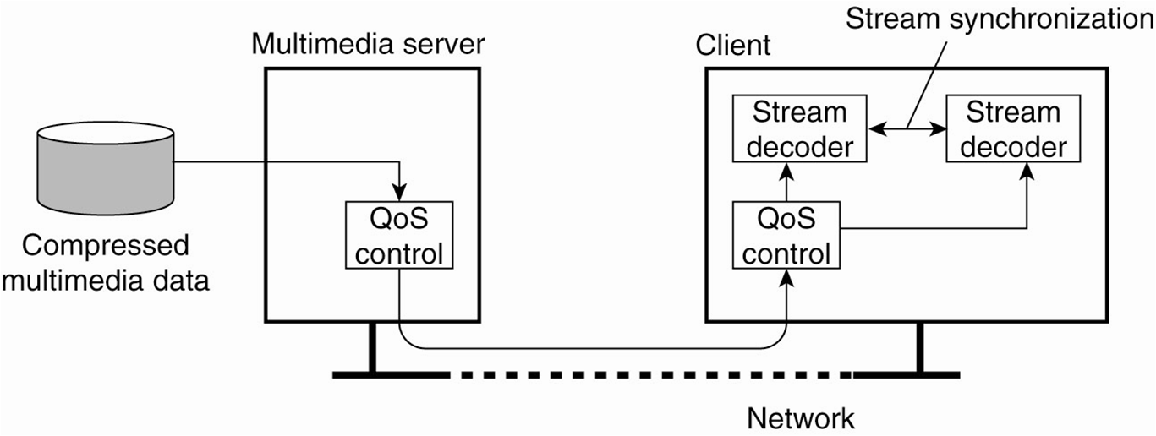
A general architecture for streaming stored multimedia data over a network
52

Slide 53
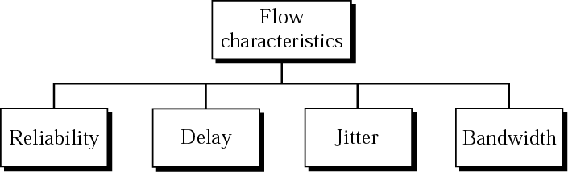
Streams and Quality of Service (QoS)
QoS requirements describe what is needed from the underlying distributed system and network to ensure acceptable delivery; e.g. viewing experience of a user
it refers to flow characteristics
Reliability
lack of reliability means losing a packet or acknowledgement, which entails retransmission for some media types
Delay
source-to-destination delay
Bandwidth
requirements of applications
53

Slide 54
Jitter
the variation in the packet arrival times belonging to the same flow
54

Slide 55
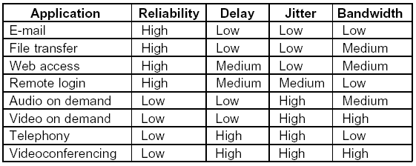
different applications have different flow characteristic requirements
55

Slide 56
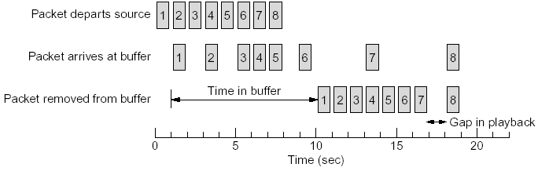
Techniques to improve Network QoS (some are useful for multimedia)
the easiest (but impractical) solution: overprovisioning - provide enough router capacity, buffer space, and bandwidth for all packets; very expensive
five common methods: buffering, traffic shaping, scheduling, admission control, and resource reservation
1. Buffering - Client Side
buffer flows on the receiving side (client machine) before delivery (playback)
it smoothes jitter (for audio and video on demand since jitter is the main problem) - does not affect reliability or bandwidth, increases delay
56

Slide 57
how long to delay is difficult - commercial Web sites that stream audio or video use players that buffer for about 10 seconds before starting to play
may not always be possible, e.g., videoconferencing
2. Traffic Shaping - Server Side
to control the amount and the rate of the traffic sent to a network
nonuniform output is common if a server is handling many streams at once and also allows other actions - such as fast forward and rewind, user authentication, ...; this may create congestion
two techniques: Leaky Bucket and Token Bucket
57

Slide 58
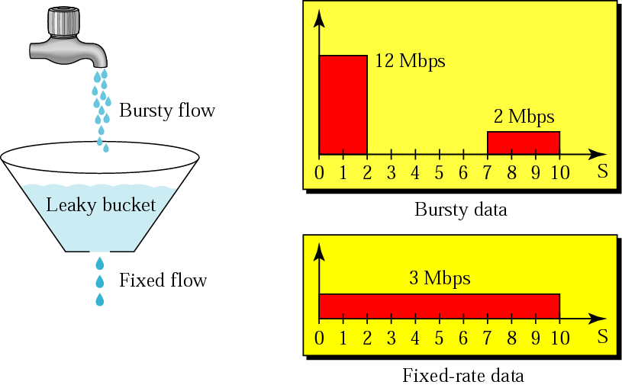
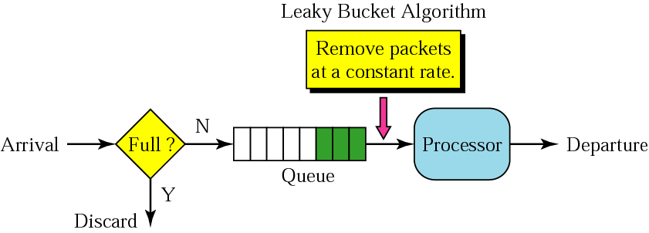
a. Leaky Bucket
Shapes bursty traffic into fixed-rate traffic by averaging the data rate
May drop packets if the bucket is full
The input rate may vary, but the output rate remains constant
58

Slide 59
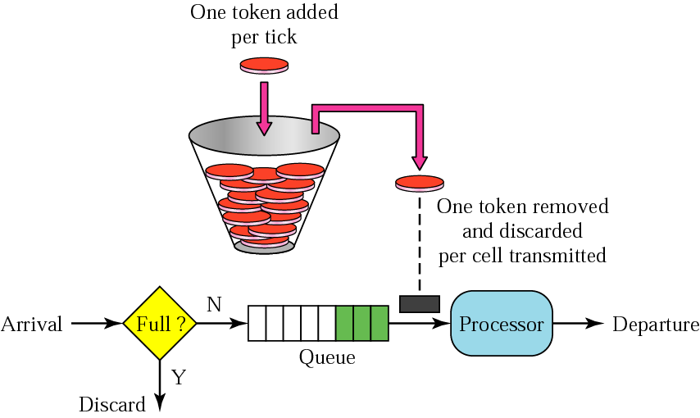
b. Token Bucket
leaky bucket is very restrictive; does not credit an idle host
token bucket allows idle hosts to accumulate credit for the future in the form of tokens
for each tick of the clock, the system sends n tokens to the bucket
the system removes one token for every cell of data sent
59

Slide 60
e.g., if n = 100 and the host is idle for 100 ticks, the bucket collects 10,000 tokens; now the host can consume all these tokens in one tick with 10,000 cells, or the host takes 1000 ticks with 10 cells per tick
that means the host can send bursty data as long as the bucket is not empty
token bucket allows bursty traffic at a regulated maximum rate
60

Slide 61
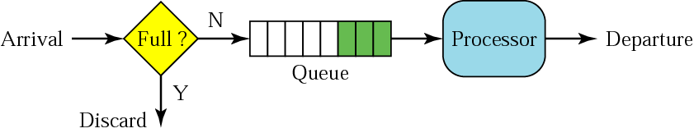
3. Scheduling - at the Routers
to avoid an aggressive sender from utilizing most of the capacity of a router; 3 commonly used scheduling methods
a. FIFO Queuing
packets wait in a buffer; if the queue fills up, new packets are discarded
61

Slide 62
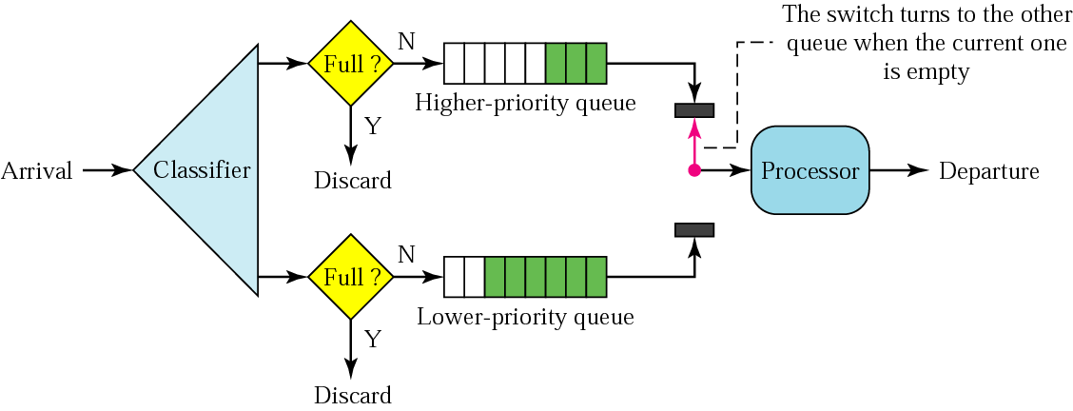
b. Priority Queuing
packets are first assigned to a priority class
there is a queue for each priority class
e.g., multimedia can be given higher priority
better QoS than FIFO, but packets in a low-priority queue may starve
62

Slide 63
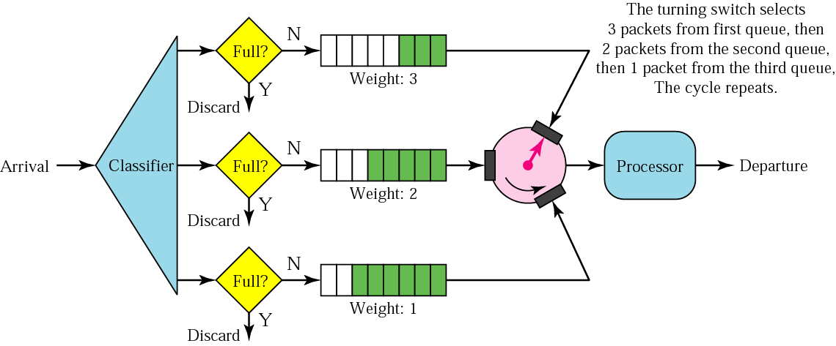
c. Weighted Fair Queuing
A modification of priority queuing to avoid starvation; packets are still assigned to priority classes
Queues are assigned weights (higher priority means a higher weight);
The system processes packets in each queue in a round-robin fashion with the number of packets selected from each queue based on the corresponding weight
A better scheduling method
63

Slide 64
4. Resource Reservation
Qos is improved if resources (buffer, bandwidth, CPU time, ...) are reserved along the path before hand
there is a specific route for a flow
Read about the following - QoS approaches by IETF
Integrated Services (IntServ) - a flow-based QoS model designed for IP
Differentiated Services (DS or DiffServ) - a class-based QoS model designed for IP
5. Admission Control
A mechanism used by a router to accept or reject a flow based on predefined parameters called flow specifications
Before it accepts a flow, it checks the flow specification to see if its capacity (buffer size, bandwidth, CPU speed, ...) and its previous commitments to other flows can handle the new flow
64

Slide 65
4.5 Multicast Communication
Multicasting: delivery of data from one host to many destinations; for instance for multimedia applications
A one-to-many relationship
1. Application-Level Multicasting
Nodes are organized into an overlay network and information is disseminated to its members (routers are not involved as in network-level routing)
How to construct the overlay network
Nodes organize themselves as a tree with a unique path between two pairs of nodes or
Nodes organize into a mesh network and there will be multiple paths between two nodes; adv: robust
2. Gossip-Based Data Transmission
Use epidemic protocols where information is propagated among a collection of nodes without a coordinator
65

